Slide 1
DETAILED ANALYSIS OF OFDM SYSTEMS
INDRANEEL SATYAJIT SANYAL
EEL-6509 COURSE PROJECT PRESENTATION

Slide 2
INTRODUCTION
Communications Growth
Different Generations of Technology
1G systems- Analog Switching Techniques. Frequency Division Multiple Access
2G Systems-Digital Switching, Time Division Multiple Access
3G systems- Code Division Multiple Access, More Mobility,
4G systems-Orthogonal Frequency Division Access, Global Mobility.
5G systems-MIMO-OFDM

Slide 3
OFDM
OFDM stands for Orthogonal Frequency Division Multiplexing.
PROCESS: It is frequency-division multiplexing (FDM) scheme used as a digital multi-carrier modulation method. A large number of closely spaced orthogonal sub-carrier signals are used to carry data on several parallel data streams or channels.
Unlike conventional FDM, this method has the orthogonality concept which prevents any cross-talk and co-channel interference.
OFDM is the basis of the 4G technology.it is popular for wideband digital communications.

Slide 4
BASICS of OFDM
As OFDM contains multiple sub-carriers, where each sub-carrier is modulated with a conventional modulation scheme like QPSK, QAMM at low data rates.
The low data rate signals when combined correspondingly form a large data rate system which then facilitates complete and efficient use of the entire frequency band.
Characteristics and Principle of Operation are to be discussed in this project.

Slide 5
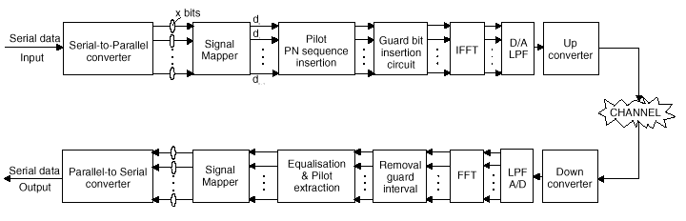
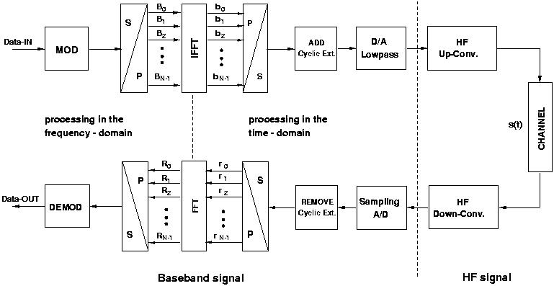
BLOCK DIAGRAM OF OFDM SYSTEM

Slide 6
Characteristics
ORTHOGONALITY CONCEPT:
All the sub-carriers are orthogonal to each other which thereby prevents cross-talk between the respective bands and eliminates the need of guard band.
It also has the advantage of not requiring sub-filters for each channel unlike conventional Frequency Division Multiplexing (FDM).
Each sub-carrier should be spaced at δF=K/T, where
δF=sub-carrier spacing, K=any positive integer, T=receiver window size.
Orthogonality allows high spectral efficiency because with a symbol rate near the Nyquist rate, it utilizes the complete frequency band.

Slide 7
OFDM requires very strong synergy between transmitter and receiver. If the sub-carriers are not orthogonal, it can induce Inter-Carrier Interference (ICI) between the consecutive bands.
Even the frequency deviation might make the orthogonal carriers non-orthogonal, this situation gets worse when multipath reflections comes into picture.
So, to prevent the interference and ICI, cyclic prefix is used as a scheme.
An example of Cyclic Prefix is using short filters at the transmitter output in order to perform a pulse shaping and an almost perfect reconstruction using a single-tap per subcarrier equalization.

Slide 8
Modulation Techniques: Monocarrier vs. Multicarrier
Advantages of Multi-Carrier:
Flat fading Per Carrier
Less Inter-Symbol interference
Less Inter-Carrier Interference
N long pulses as compared to a single pulse

Slide 9
Fast Fourier Transform (FFT) Implementation
The principle of operation and benefits of OFDM were known during the 1970s, but due to the absence of proper signal processing techniques, it was not economical those days.
Now, due to the advent of low-cost digital signal processing techniques and components, OFDM process ahs become cost-effective.
The time to compute the IFFT and FFT of the symbols will take roughly in the order of microseconds (μs).
The computational demand approximately scales linearly with FFT size.

Slide 10
Guard Interval Insertion
Now, as low symbol rates are less affected by Inter-Symbol Interference (ISI), it is very economical and advantageous to transmit number of low data rate streams instead of single stream.
Now, as symbol length is long, it is economical to insert a guard interval between symbols, thereby eliminating ISI.
Guard band insertion gives us an additional advantage as no specific pulse-shaping filter will also be required.
Cyclic prefix as discussed earlier will be transmitted at the end of the signal consists of end of the OFDM symbol copied at the end of the guard band.
The reason as the guard band will contain he cyclic prefix so that the receiver will integrate the all the prefix signals over an integer number of sinusoid cycles for each of the multipath.

Slide 11
EQUALIZATION
Single carrier systems employ time-domain channel equalization
OFDM employs frequency domain equalization which is simpler as compared to time-domain equalization.
In OFDM, the channel equalization concept is each information in each sub-carrier is multiplied by a constant complex number which rarely changes over the complete process.
Now, in special cases where DQPSK,DPSK modulation are used, the equalization can be completely omitted since these non-coherent schemes are insensitive to slowly changing amplitude.

Slide 12
Equalization in OFDM is easier to implement as the sub-carriers are adaptable to other methods rather than just the variable coefficient methods such as different QAM constellation schemes.
Now, it may also be a case that some of the OFDM signals might carry Pilot signals, which provides measurement of channel conditions.
Now, together with the pilot signals and training signals, channel equalization can help in time synchronization (elimination of ISI) and frequency synchronization (elimination of ICI).

Slide 13
Channel Coding and Interleaving
Channel coding is invariably used in OFDM and time or frequency interleaving are always used in OFDM process.
Frequency interleaving decreases the possibility of fading in frequency-selective channels.
Frequency interleaving ensures that the faded sub-carriers bit errors get spread out over the complete band rather than remain concentrated in a small part.
Time interleaving spreads out all the bits which originally together in the bit stream to mitigate the effects of fading when travelling at high speed.

Slide 14
The reason why interleaving is used on OFDM is to attempt to spread the errors out in the bit-stream that is presented to the error correction decoder, because when such decoders are presented with a high concentration of errors the decoder is unable to correct all the bit errors, and a burst of uncorrected errors occurs.
An example of interleaving coding use din OFDM systems is convolutional coding and Reed-Solomon coding.
Newer systems are based on turbo codes principle which uses optimal error correction technique.
Examples of new systems are LDPC codes, turbo code which perform close to Shannon Limit.

Slide 15
Transmission Adaptation
The resistance to the channel interference can be again enhanced if the information is sent over a return channel.
Therefore, channel coding, adaptive modulation may be applied to all the sub-carriers.
The term Discrete Multitone Modulation (DMT) denotes OFDM based communication systems that adapt the transmission to the channel conditions individually for each sub-carrier, by means of so-called bit-loading concept.

Slide 16
OFDM with Multiple Access (OFDMA)
OFDM in its primary form is considered as a digital modulation technique, and not a multi-user channel access method, since it is utilized for transferring one bit stream over one communication channel using one sequence of OFDM symbols. However, OFDM can be combined with multiple access using time, frequency or coding separation of the users.
In orthogonal frequency-division multiple access (OFDMA), frequency-division multiple access is achieved by assigning different OFDM sub-channels to different users. OFDMA supports differentiated quality of service by assigning different number of sub-carriers to different users in a similar fashion as in CDMA, and thus complex packet scheduling or Media Access Control schemes can be avoided.

Slide 17
OFDMA
OFDMA is also a candidate access method for the IEEE 802.22 Wireless Regional Area Networks (WRAN). The project aims at designing the first cognitive radio based standard operating in the VHF-low UHF spectrum (TV spectrum).
In Multi-carrier code division multiple access (MC-CDMA), also known as OFDM-CDMA, OFDM is combined with CDMA spread spectrum communication for coding separation of the users. Co-channel interference can be mitigated, meaning that manual fixed channel allocation (FCA) frequency planning is simplified, or complex dynamic channel allocation(DCA) schemes are avoided.

Slide 18
Linear Transmitter Power Amplifier
An OFDM signal exhibits a high peak-to-average power ratio (PAPR) because the independent phases of the sub-carriers mean that they will often combine constructively. Handling this high PAPR requires:
A high-resolution digital-to-analogue converter (DAC) in the transmitter
A high-resolution analogue-to-digital converter (ADC) in the receiver
A linear signal chain.
Any non-linearity in the signal chain will cause intermodulation distortion that
raises the noise floor
may cause inter-carrier interference
generates out-of-band spurious radiation.

Slide 19
The linearity requirement is demanding, especially for transmitter RF output circuitry where amplifiers are often designed to be non-linear in order to minimize power consumption. In practical OFDM systems a small amount of peak clipping is allowed to limit the PAPR in a judicious trade-off against the above consequences. However, the transmitter output filter which is required to reduce out-of-band spurs to legal levels has the effect of restoring peak levels that were clipped, so clipping is not an effective way to reduce PAPR.
Although the spectral efficiency of OFDM is attractive for both terrestrial and space communications, the high PAPR requirements have so far limited OFDM applications to terrestrial systems.

Slide 20
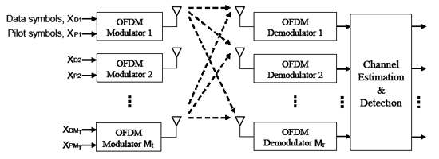
OFDM with Multiple Input Multiple Output(MIMO)

Slide 21
MIMO-OFDM is a popular wireless communication technique used in 4G and will be used in 5G technology.
It couples and combines both aspects of MIMO and OFDM
MIMO- Multiple Input Multiple Output signifies multiplying capacity by transmitting different signals through multiple antennas simultaneously.
OFDM-multiple subcarriers as stated earlier
MIMO-OFDM is the foundation for most advanced wireless local area network because it achieves the greatest spectral efficiency and therefore, delivers the highest capacity and data throughput.
While multiple transmit antennas can be used for beamforming, and multiple receive antennas can be used for diversity, MIMO generalizes multiply spectral efficiency.

Slide 22
OPERATION
OFDM enables reliable broadband communications by distributing user data across a number of closely spaced, narrowband sub channels.
This arrangement makes it possible to eliminate the biggest obstacle to reliable broadband communications, intersymbol interference (ISI).
ISI occurs when the overlap between consecutive symbols is large compared to the symbols’ duration. Normally, high data rates require shorter duration symbols, increasing the risk of ISI.
By dividing a high-rate data stream into numerous low-rate data streams, OFDM enables longer duration symbols. A cyclic prefix (CP) may be inserted to create a (time) guard interval that prevents ISI entirely.
If the guard interval is longer than the delay spread—the difference in delays experienced by symbols transmitted over the channel—then there will be no overlap between adjacent symbols and consequently no intersymbol interference.
Though the CP slightly reduces spectral capacity by consuming a small percentage of the available bandwidth, the elimination of ISI makes it an exceedingly worthwhile tradeoff.

Slide 23
MIMO-OFDM is a particularly powerful combination because MIMO does not attempt to mitigate multipath propagation and OFDM avoids the need for signal equalization.
MIMO-OFDM can achieve very high spectral efficiency even when the transmitter does not possess channel state information (CSI).
When the transmitter does possess CSI (which can be obtained through the use of training sequences), it is possible to approach the theoretical channel capacity.
More recent MIMO-OFDM developments include multi-user MIMO (MU-MIMO), higher order MIMO implementations (greater number of spatial streams), and research concerning “massive MIMO” and “Cooperative MIMO” for inclusion in coming 5G standards.

Slide 24
APPLICATIONS
Digital Audio Systems
4G technology( LTE and LTE-Advanced)
Digital television Systems
WiMAX
Wireless LAN IEEE 802.11a, IEEE 802.11g, IEEE 802.11n, IEEE 802.11ac, and IEEE 802.11ad;
HIPERLAN/2
IEEE 802.16 Broadband Wireless Access System.
Wireless ATM transmission system

Slide 25
ADVANTAGES
High Spectral Efficiency
Robust to multipath distortion
Resistant to Radio Frequency interference
Equalization is Easy-: OFDM symbols are longer than the maximum delay spread resulting in flat fading channel which can be easily equalized.
Flexibility-each transceiver has access to all subcarriers within a cell layer.
High transmission bitrates.
Chance to cancel any cannel if is affected by fading.

Slide 26
Multipath delay spread tolerance: OFDM is highly immune to multipath delay spread that causes inter-symbol interference in wireless channels. Since the symbol duration is made larger (by converting a high data rate signal into N low rate signals), the effect of delay spread is reduced by the same factor. Also by introducing the concepts of guard time and cyclic extension, the effects of inter-symbol interference (ISI) and inter-carrier interference (ICI) can be removed.
Immunity to frequency selective fading channels: in the case of OFDM the available bandwidth is split among many orthogonal narrowly spaced sub-carriers. Thus the available channel bandwidth is converted into many narrow flat- fading sub-channels. Hence it can be assumed that the subcarriers experience flat fading only, though the channel gain/phase associated with the sub-carriers may vary.

Slide 27
DISADVANTAGES
High synchronism accuracy.
Multipath propagation must be avoided in other orthogonality not be affected.
Large peak-to-mean power ratio due to the superposition of all subcarrier signals, this can become a distortion problem.
More complex than single-carrier Modulation.
Requires a more linear power amplifier.
The OFDM signal has a noise like amplitude with a very large dynamic range, therefore it requires RF power amplifiers with a high peak to average power ratio.
It is more sensitive to carrier frequency offset and drift than single carrier systems are due to leakage of the DFT.
High power transmitter amplifiers need linearization.
Low noise receiver amplifiers need large dynamic range.
Capacity and power loss due to guard interval.
Bandwidth and power loss due to the guard interval can be significant.

Slide 28
CONCLUSION
OFDM is a very beneficial technique when it comes to elimination of ISI and ICI. Being robust to the multipath spread loss, it is today a growing technology. It is the backbone of the 4G technology.
Being such a revolutionized technique and from all the simulations, I conclude that with the 5G in development, OFDM promises to be another cornerstone for the technology where Internet of Things and Big Data.
There are also some shortcomings of the technique which can be removed using supportable techniques.

Slide 29
THANK YOU
OFDM SYSTEMS

